Slide 1
Team Point-Blank
Ankit Arora, Rhea Chatterjee, Daniel Dias, Pradyumna Mukunda, & Kedi Zheng

Slide 2
It’s year 2055 and robots have taken over the city of Atlanta. The governor has been kidnapped and held hostage. It is your mission to save the governor and reclaim the city by defeating the robots and their army of cyborg ninjas. Do you have what it takes to save the human race from its worst nightmare yet?

Slide 3
Game Feel Characteristics
Real-Time Control
Third person shooter
Climbing
Jumping
Switching weapons
Polish
Level graphics
Different weapons
HUD with health & overheat
Sound Effects
Simulated Space
Flying cars spawn enemies
Collisions with obstacles throughout the level

Slide 4
Final Product
Only 1 level
Focus on player and enemy details
Character movements
Different weapons
Enemy ragdoll

Slide 5
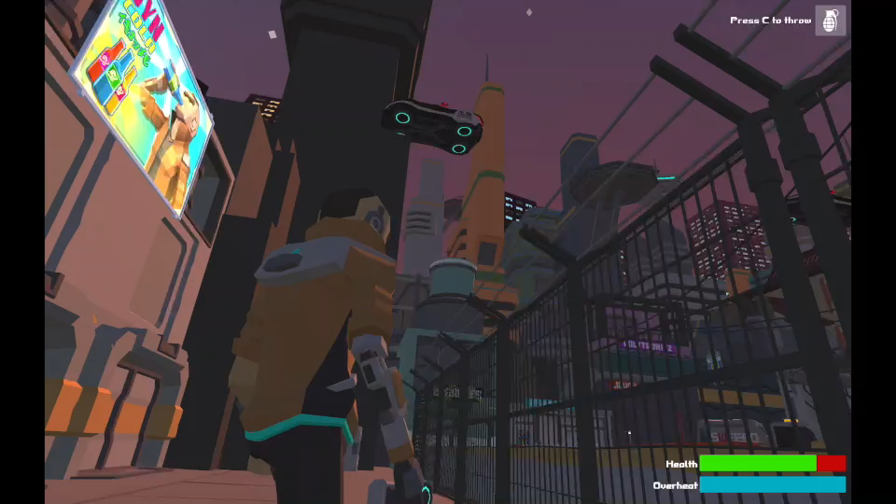

Demo:

